Slide 1
Seminar 2 Design of Informatics Systems
UML Use case diagram

Slide 2
Use case
Specifies a set of actions executed by a system or a subject that lead to a certain result.
The result, normally, is important for an actor or a beneficiary.

Slide 3
Actors
An actor interacts with the system in the context of a use case.
Actors are roles that can include human factors, external hardware or other systems.
Answer to questions like:
WHO requests information from the system
WHO modifies information in the system
WHO interacts with the system
It is represented in a diagram with the specific symbol of a little man.

Slide 4
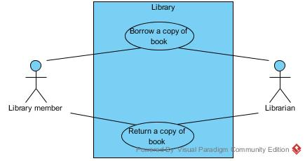
Use Case Diagram
It describes the relationship between a set of use cases and actors who participated in these UC.
UC diagrams do not describe behaviors or streams.
It can define the boundaries of the analyzed system by incorporating the use cases within a rectangle

Slide 5
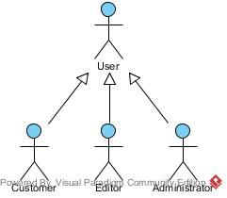
Relationsips between actors
Are of the type generalization / specialization between an abstract actor and one or more concrete actors

Slide 6
Relationsips between actors and use cases - 1
Simple associations are used to connect an actor with a use case.
It is a way of communication between the two.
The communication can be unidirectional as well.

Slide 7
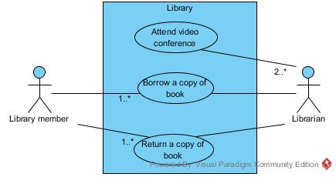
Relationsips between actors and use cases - 2
At this level multiplicities are allowed
multiplicity greater than one at the end:
corresponding to the Use case ⇨ the actor is involved in several use cases of that type and can initiate use cases: in parallel (concurrently) at different points in time or mutually exclusive in time.
corresponding to the Actor ⇨ multiple instances of the actor are involved in initiating the use case and can perform simultaneous and successive actions.
UML does not have standard notations for the above situations.

Slide 8
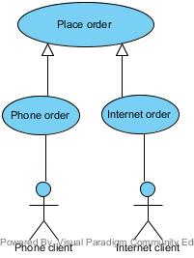
Relashionships between use case - 1
1. Generalization
It is used when there are two or more UC who have in common behavior, structure and purpose.
The behavior of the parent UC can be overridden.
Only the differences between the two cases are specified in the specialized use case.

Slide 9
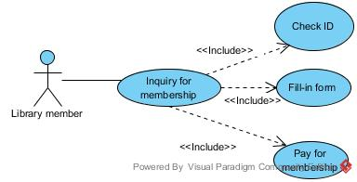
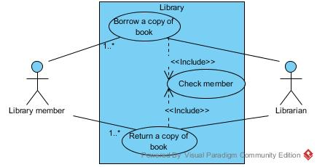
Relashionships between use case – 2
2. Include
It aims to integrate an use case in another use case, the first becoming a logical part of that UC. The UC that includes another is not complete.
It is used when:
there are parts of behavior common to several use cases
to simplify large UC.
It is equivalent to call a subroutine in programming.
Denotes a mandatory behavior, not an optional one.
There are no properties inherited from a UC to another.
It avoids redundancy of parties with identical behavior

Slide 10
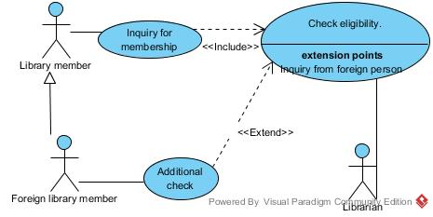
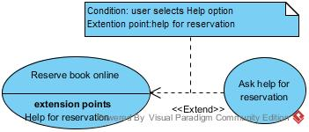
Relashionships between use case – 3
3. Extend
It is used when a CU occurs only under certain conditions or it is optional.
The extended UC is complete and independent from the one it expands.
Extension occurs in one or more extension points
You can associate notes or constraints to that relationship to illustrate the conditions in which the extended behavior must be executed.

Slide 11
Textual description of a UC
Element of the use case | Description
Code | Unique identifier associated to the use case
State | The stage of completion it is in, for example, outline, completed or approved
Purpose | The system (or part of the system) or application to which it belongs
Name | Name of the use case,as short and representative as possible
Main actor | The beneficiary who initiates the use case and pursues a particular purpose
Description | Short presentation, in free text, of the use case
Preconditions | What conditions must be satisfied for the script can begin
Postconditions | What conditions must be met to ensure a successful end of the scenario
Trigger | An event or sequence of events that initiate the use case
Basic flow | The basic flow describes the basic flow of events when everything is going according to a predetermined script; there are no exceptions or errors
Alternate flows | The most significant exceptions and alternatives to the baseline scenario
Relashionships | What relationships it has with other use cases (include or extend)
Frequency of use | How often it is expected to use this system functionality
Business rules | What rules govern the use case

Slide 12
Lucru la seminar
Create the general use class diagram and the textual description for a use case,for the scenario below
The project goal is to develope a software application for the management of a hotel business unit. In order to check in, a customer can request to reserve one or more rooms by e-mail or telephone. For this, he provides the receptionist with information on the period of accommodation and type of rooms required. Customers will get discounts if they reserve at least 3 rooms or if the period of accommodation exceeds 5 days. The receptionist checks availability and notifies the client of this and the estimated cost of accommodation. If there are no rooms available as requested, the receptionist can provide alternatives to the customer. The client may request a discount (additional or not) and the receptionist will decide the feasibility discount, assisted mandatory by the hotel manager. If the client agrees with the proposed price, they proceed to the reservation. For new customers, the receptionist asks identification data, which he introduces in the application.
Once at the hotel and if it has made a prior booking, the customer will provide his identification and / or booking number and the check in is finalized. If there is no reservation, the availability for the required period will be checked. When there is such a room, accommodation is made. At the end of the stay, the receptionist prepares a list of all the services used by the customer and their price. The list must be validated by the customer, then the final invoice is drawn up. The invoice can be paid partially or fully by bank transfer, cash or using a credit card. Also, before leaving the hotel, the customer is asked to complete a form to evaluate the services provided by the hotel premises

